Slide 1
Level 1 Business Project:
Restaurant Designer
By Daniel-Ian Smith

Slide 2
Work Activity Brief
Course | Level 1 Business Administration
Project Title | Restaurant Designing
Tutor | Daniel-Ian Smith
Issue date | April 2020 | Completion date | August 2020
Project overview You have been tasked with designing the layout for a new restaurant that will be opening soon. The owners have provided you with a list of appliances/furniture they are planning on buying for their restaurant and your job is to design the floor plan and provide a planning statement. Once you have completed your project, please forward this to the following email address along with your full name: submissions@esc.ac.uk. We’ll then forward this on to our curriculum teams who will be in touch shortly.
Outcome of the project This project has been developed to help you to prepare for the programme that you will be joining in September. It will hopefully give you some insight into the subject area and develop skills of working independently as you will be required to do as a College student.

Slide 3
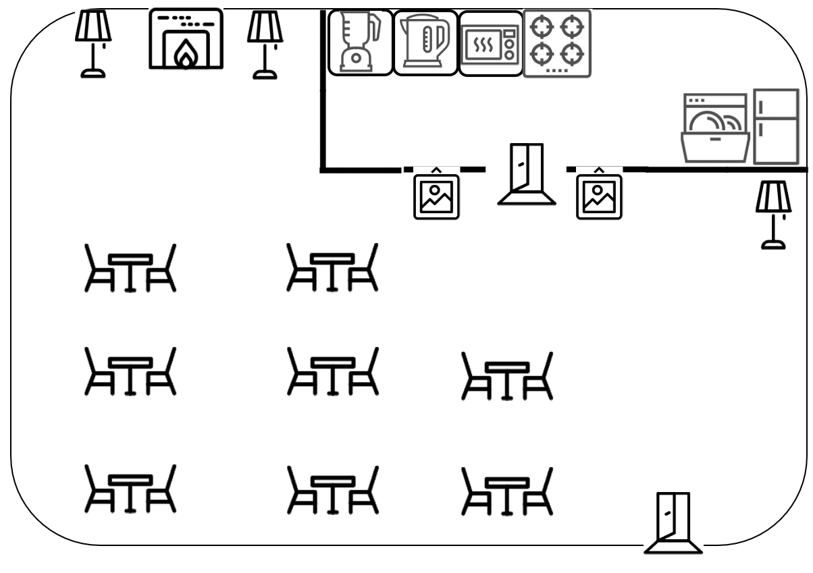
Scenario:
You have been tasked with designing the layout for a new restaurant that will be opening soon.
The owners have provided you with a list of appliances/furniture they are planning on buying for their restaurant, use the template on the next slide to create your floor plan by dragging and dropping each icon into your desired location.
(It’s optional how many of each appliance/furniture you use out of the maximum amount shown)
Once you have completed the floor plan you need to provide a Planning Statement giving reasons for your proposed layout and why it would benefit the restaurant.
Use the copy-paste feature (ctrl-c | ctrl-v) to duplicate the required number needed for your layout.
Example:

Slide 4
Floor Plan:
x1:
Wall:
Tabletop:
Seating Area:
Lamp:
Door:
Picture:
x14
x5
x7
x4
x3
x2

Slide 5
Planning Statement:
Floor Plan:
Eg We placed the TV on the top left wall so it is the furthest away from the door so no noise will distract other areas of the college.

