Slide 1
Work Activity Brief
Course (s) | AAT Accounting Level 2
Project Title | AAT Lolly Challenge
Tutor/s | Jo McDonagh
Issue date | April 2020 | Completion date | August 2020
Project overview We may be in Lockdown but you are challenged to develop a ‘healthy’ ice cream/lolly to enjoy whilst watching your favourite film. Your lolly should encourage your friends or families to use healthy ingredients in the kitchen (it may even disguise those Brussel sprouts)! To finish your entry, you should take a picture of your lolly and add it to your presentation ready for judging. This project will provide you with the individual study skills in preparation for your study programme. At East Surrey College we encourage our students to be independent learners. This means: Being organised Being self-motivated Being curious to learn Being ready to contribute to learning Why focus on study skills? Because reflecting on HOW we learn, is just as important as WHAT we learn Once you have completed your project, please forward this to the following email address along with your full name: submissions@esc.ac.uk. We’ll then forward this on to our curriculum teams who will be in touch shortly. .
Outcome of the project This project has been developed to help you to prepare for the programme that you will be joining in September. It will hopefully give you some insight into the subject area and develop skills of working independently as you will be required to do as a College student.

Slide 2
So you Want to Work With Money?
Welcome to the AAT Keep Warm Challenge

Slide 3
Love Your Lollies - Slogan
Lightning Kiwi Twist
Keep cool while humming to our soundtrack with a BBL Strawberry Ice
Spiderman Special
Improve your special powers with a tropical tangy twist.

Slide 4
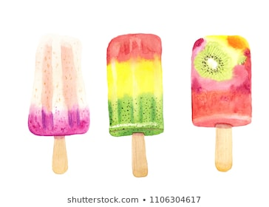
Your Challenge
Summer is here!
The Challenge:
We may be in Lockdown but you are challenged to develop a ‘healthy’ ice cream/lolly to enjoy whilst watching your favourite film.
Your lolly should encourage your friends or families to use healthy ingredients in the kitchen (it may even disguise those Brussel sprouts)!
To finish your entry you should take a picture of your lolly and add it to your presentation ready for judging.

Slide 5
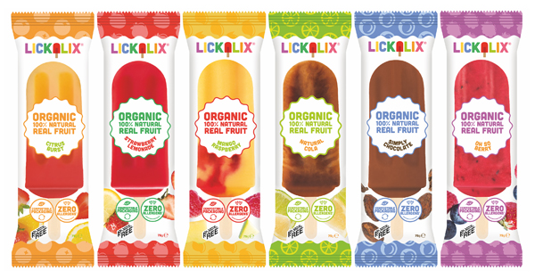
The Brief:
You are to design, cost and prepare your offering based on the following:
Ingredients must include 2 of your ‘5 a Day’
Packaging should be eco friendly
It must be made up of at least 2 of the included items
Go Large! You should provide costs for the manufacture of 100 units if successful
You should create a simple marketing campaign which must include a slogan
Assume all items will need VAT at 20% added (NB for costing exercise purpose only!)

Slide 6
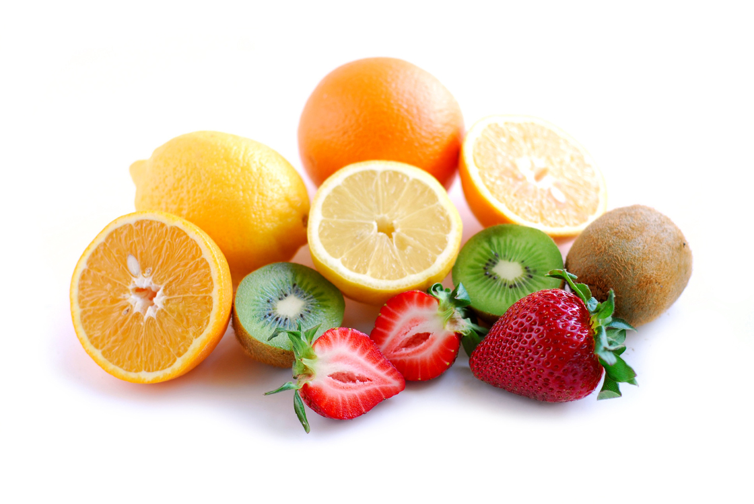
Ingredients (You must include at least 2)
Chocolate
Coffee Bean
Vanilla
Cookie Crumb
Passion fruit
Pineapple
Kiwi
Celery
Cream
Yogurt
Cola
Satsuma
Toffee
Caramel crumb
Shortcake
Raspberry
Strawberry
Banana
Sparkles
Sprinkles
Lemon
Lime
Sherbet
Mint
Ginger
Avocado
Tomato
Spinach

Slide 7
The Mandatory Costing
Item | Quantity | Cost per unit | Inc. VAT | Total Cost

Slide 8
Additional Items
Item | Q | £/U | Inc. VAT | Total Cost

Slide 9
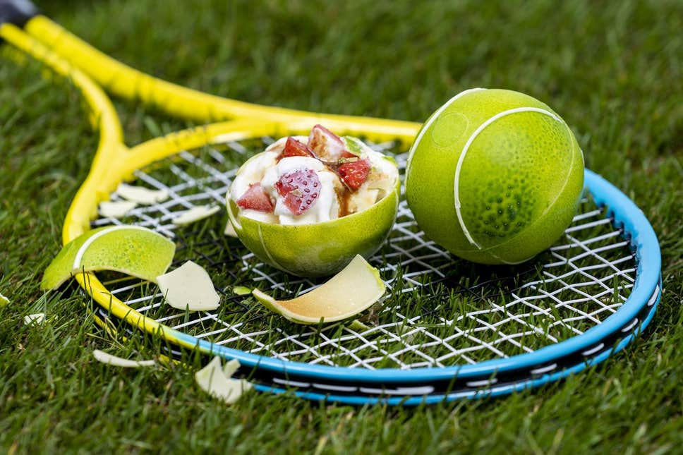
The Advertisement
Your advert should contain:
Graphic/s
Costings
Logo/slogan
Now is the time to be original!

