Slide 1
Welcome to East Surrey College

Slide 2
Project Overview
Course | Business Level 2
Project Title | Coco-Cola Business Challenge Work Based Project
Tutor/s | Nick Nathanial
Issue date | April 2020 | Completion date | August 2020
Project overview This year Coca Cola will be supporting the Special Olympics Great Britain (SOGB), a fantastic charity that works to provide year-round sports training and athletic competition in a variety of Olympic-type sports for children and adults with intellectual disabilities. This project asks you to form a company and develop a new, sustainable, healthy juice brand. Coca Cola plan to launch a promotional campaign for the new product at the beginning of the Special Olympics in September 2020. Once you have completed your project, please forward this to the following email address along with your full name: submissions@esc.ac.uk. We’ll then forward this on to our curriculum teams who will be in touch shortly.
Outcome of the project This project has been developed to help you to prepare for the programme that you will be joining in September. It will hopefully give you some insight in to the subject area and will support the development of your skills of working independently as well as assignment writing.

Slide 3
Project Tasks
These are the tasks that you need to complete and will support you to structure your work
Task 1: Coca-Cola European Partners (CCEP) would like you to come up with a new juice drink brand that has clear health benefits, is sustainable and a great commercial proposition.
The drink must be original, with an original brand name, logo and slogan. It must be presented in a 500ml package and it must support Special Olympics Great Britain’s Play Unified campaign through a clever on-pack promotion. In this project you must look at various external factors that may affect the idea for your new juice drink.
You are required to consider a budget for the campaign and costings for the juice drink. Ensure that you research into, and provide a clear indication of who your target audience are with examples of how you intend to capture their attention.
Please follow through the Coca-Cola PowerPoint (attached to this brief) that will help you complete this project.

Slide 4
Business Challenge Work Based Project Level 2 2019/20

Slide 5
Introduction
This year, Coca Cola will be supporting Special Olympics Great Britain (SOGB), a fantastic charity that works to provide year-round sports training and athletic competition in a variety of Olympic-type sports for children and adults with intellectual disabilities.
This project asks you to form a company and develop a new, sustainable, healthy juice brand. Coca Cola plan to launch a promotional campaign for the new product at the beginning of the Special Olympics in September 2020.

Slide 6
The Brief
You should ensure you read the brief below carefully. It might be worth setting your own deadlines to ensure each job is done in good time.
Coca-Cola European Partners (CCEP) would like you to come up with a new juice drink brand that has clear health benefits, is sustainable and a great commercial proposition.
The drink must be original, with an original brand name, logo and slogan. It must be presented in a 500ml package and it must support Special Olympics Great Britain’s Play Unified campaign through a clever on-pack promotion. In this project you must look at various external factors that may effect the idea for your new juice drink.
You are required to consider a budget for the campaign and costings for the juice drink. Ensure that you research into, and provide a clear indication of who your target audience are with examples of how you intend to capture their attention.

Slide 7
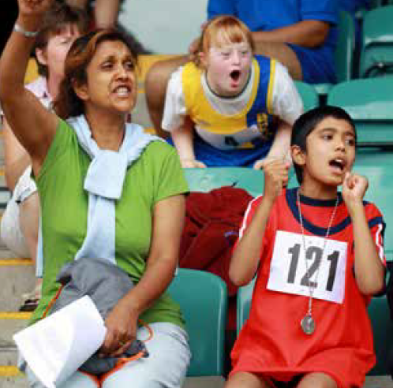
Special Olympics
SOGB is a fantastic charity that works to provide year-round sports training and athletic competition in a variety of Olympic-type sports for children and adults with intellectual disabilities.
The Play Unified Sport campaign promotes inclusion through bringing together people with and without intellectual disabilities to train and compete on the same teams and in the same competitions. The sports in focus for the Play Unified campaign will be basketball and football. Use the fact sheets provided and the links below for more information:
Remember you need to include a promotion on your drink’s packaging that encourages young people to support and get involved in the Play Unified campaign (see page 18).
Special Olympics Great Britain homepage | http://www.specialolympicsgb.org.uk/
Play Unified homepage and video | http://www.playunified.org/
Video showcasing last summer’s Special Olympics World Games . | https://www.youtube.com/watch?v=TPRPYmp-BRQ

Slide 8
Research and Development
It is strongly suggested that you do some market research in the following areas:
The Soft Drinks Market
There are many different drinks on the market, from carbonated soft drinks to milkshakes, smoothies, and energy drinks. For your drink to be a good business proposition, it will help if it stands out from the crowd. Develop your product so that it has a unique flavour or an innovative packaging concept or some other kind of unique selling point (USP).
We suggest you do some market research to find out what drinks are already on the market, what tastes are popular, what types of packaging people like, and so on. You may want to illustrate your market research in your PowerPoint presentation.
2. Ingredients and Packaging
What ingredients are you going to use? Look into the benefits of different ingredients and also where your ingredients are coming from. Remember your drink needs to be as sustainable as possible. Is your drink going to be in a can or bottle, or some other kind of packaging? You should also look into the sustainability of different materials.
3. Special Olympics Great Britain and Play Unified
Look at the resources on page 4 and the factsheets provided and ensure you understand what this great charity and their Play Unified campaign are all about. Remember you need to promote Play Unified on your drink to encourage young people to get involved.

Slide 9
Type of Drink
Consider the questions below in order to develop your juice brand.
Give your product a Unique Selling Point (USP) so it stands out from the crowd.
Remember you must detail the ingredients (see page 10), as well as develop the brand (see page 14).
How much will the drink cost?
What flavour is your drink?
What is your USP?
What are the key ingredients?
Who is your target market?
Who is your competition?

Slide 10
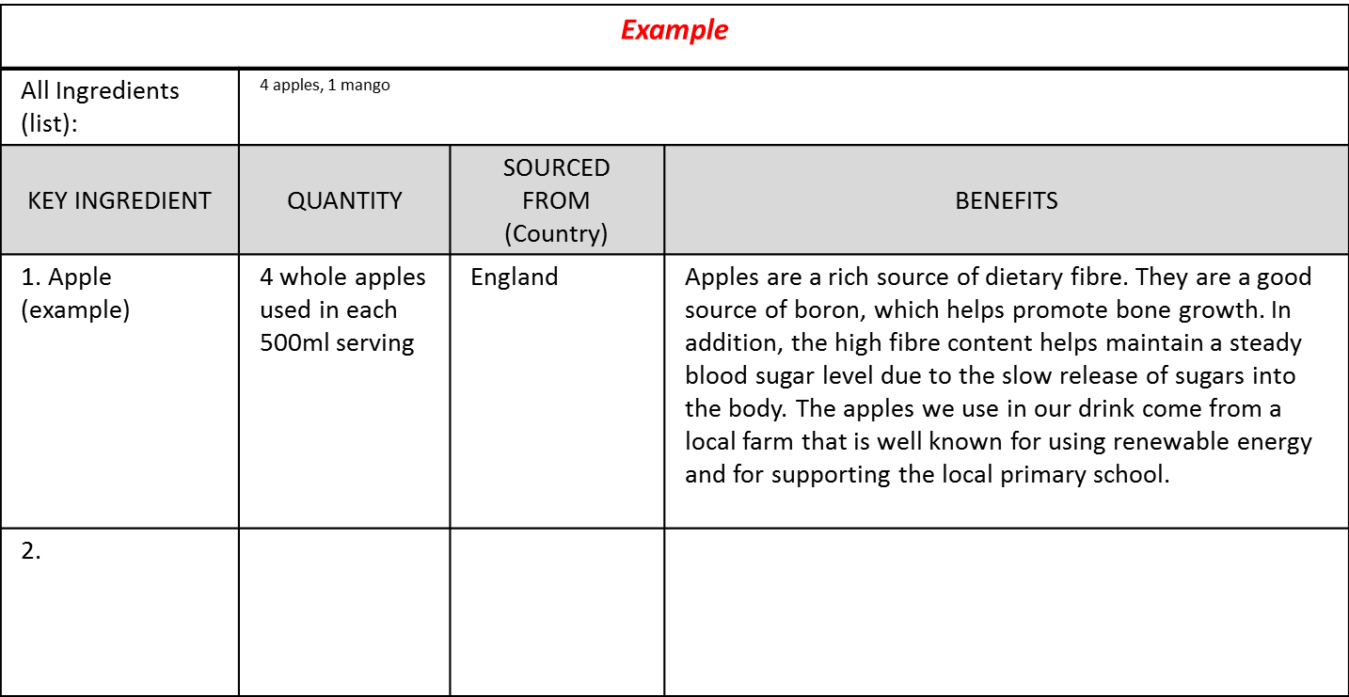
Ingredients
On the Ingredients Sheet (page 11), list all the ingredients that your healthy juice brand contains.
The Ingredients Sheet should be included in your PowerPoint presentation.
Choose two ingredients and detail why you have chosen them.
Think about the health benefits that the ingredients may provide.
Explain some ethical choices you made in deciding on your ingredients. For example, are they Fairtrade?
Take into consideration that you will also need to complete a sheet giving some details on nutrition and guideline daily amounts (GDAs).

Slide 11
Ingredients Sheet
Include in PowerPoint
Brand Name:
All Ingredients (list):
KEY INGREDIENT | QUANTITY | SOURCED FROM (Country) | BENEFITS
1.
2.

Slide 12
Nutrients and GDAs*
Food and drink products use Guideline Daily Amount (GDA) figures to help put nutrition information into the context of an overall diet.
They are called guidelines because that's exactly what they are: a guide, not a target, as to how much of each nutrient it is healthy to consume each day.
The figure can be an approximation but should be the figure per 100ml (remember your drink is 500ml). We suggest you use the internet to get an approximate figure for the amount of nutrients in your ingredients.
Example: Drink contains 1 apple. 1 apple contains approx. 23g sugars. GDA = 23/90 x 100 = 25.5%. Divide both figures by 5 to give figure for 100ml serving = 4.6g/5.1%
GDA Values
Calories | 2,000 kcal
Fat | 70g
Sugars | 90g
Saturates | 20g
Salt | 6g

Slide 13
Include in PowerPoint
GDAs Sheet
Nutritional Information per100ml (GDA based on 2000 kcal diet)
Calories
0.0kcal
Sugars
0.0g
Fat
0.0g
Saturates
0.0g
Salt
0.0g
0%
0%
0%
0%
0%

Slide 14
Brand Development
By now you should be clear about what your juice tastes like ,so now you need to develop a brand with a unique identity and think of ways of marketing it.
Think about the areas below and build your ideas into an illustration of your product for your PowerPoint presentation.
Refer to page 12 when considering how to package your drink, and feel free to propose any marketing ideas in your PowerPoint presentation.
Brand
Name
Logo
Promotion
Slogan
Price*
Label and Packaging
* It is suggested you complete the “Cost and Profit Projection” section before deciding on your price.

Slide 15
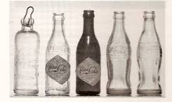
Packaging and Drink Illustration
What sort of packaging are you going to use for your product?
We have specified that it needs to be a 500ml serving, but what materials are you going to use?
You can choose plastic, aluminium, card or glass. It is your decision but bear in mind that different packages have varying impacts on the environment.
Perhaps you have an innovative design idea you would like to incorporate.
What labels and colour schemes are you going to use?
You need to illustrate your packaging design in your PowerPoint presentation. Your illustration should clearly show the material you’re using, how your package is sealed (e.g. bottle top) as well as any label, logos or colour scheme you’ve used to bring your brand to life.

Slide 16
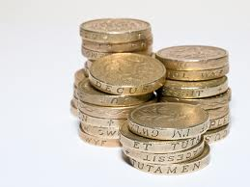
Cost and Profit Projection
You should now consider an estimated of cost and profit you will make selling your juice drink, you need to work out a projection based on making 900,000 litres in 500ml containers.
TIP: How many containers does that mean you will have to make?
In order to do this you will need to make some assumptions and base your projection on the costs listed on page 17.
You will then need to complete the Cost, Price and Profit sheet on page 18.
This sheet needs to be included as a slide in your PowerPoint presentation.

Slide 17
Production Costs
PACKAGING Choose the type of packaging you want to use and include cost of labelling and other packaging.
Recycled plastic | 15p per container
Recycled aluminium | 10p per container
Recycled card | 8p per container
Recycled glass | 24p per container
Labels and other packaging (e.g. stretch wrap) | 2p per container
KEY INGREDIENTS You must work out the cost for any fruit or vegetable that is on your ingredients sheet. You must assume you are using water in your drink and factor in this cost. If you have other ingredients (e.g. vitamins, herbs etc.) , for the purposes of this estimate you do not need to calculate or add this additional cost.
Fruit or vegetable | 15p per litre for each fruit or veg
Water (purified) | £150 per 5000 litres (please include this cost even if you do not intend to use water in your product)
OTHER PRODUCTION COSTS
Labour | £120 per hour (assume you can make 500 containers a minute)
Distribution | £500 per 200,000 containers

Slide 18
Include in PowerPoint
Cost, Price and Profit Sheet
Packaging
Ingredients
Labour
Distribution
Marketing Cost | £350,000 (fixed)
Total Cost
Cost per container
Suggested selling price* (*This is your decision. Think about your target market and what they would be prepared to pay, as well as ensuring you make a profit.)
Profit per container
Total Profit (Assume 80% of containers are sold)

Slide 19
Play Unified Promotion
You should carry an on-pack promotion that encourages young people, aged 14-25, to get involved with Special Olympics Great Britain’s Play Unified campaign. Use one slide in your PowerPoint presentation to illustrate and explain how you could do this using your drink’s packaging as well as point of sale displays. Your promotion could support Play Unified in one or some of the ways below or you may have another idea.
Encourages young people to get involved in Unified Sports (which is part of the Play Unified Campaign) which brings together people with intellectual disabilities and people without to train and compete on the same teams and in the same competitions.
Notes:
OPTION 1

Slide 20
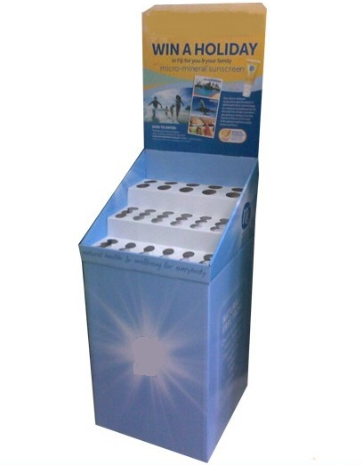
Play Unified Promotion: Tips
As well as your drink’s packaging,
Think about how you could use
Point of sale, like this.
Have a clear message!
Message
Drinks
How can you use social media in
your promotion?
Look at other on-pack promotions
for inspiration.
Use Play Unified Branding.

Slide 21
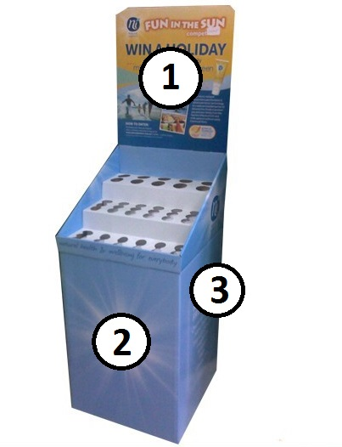
Play Unified Promotion: Point of Sale Display Template
1
3
2
3

Slide 22
Judging Criteria:
Answering The Brief | Have you read the instructions carefully and come up with the type of product we have asked for?
Viability | Is your idea realistic? Is it something Coca-Cola might invest in? Completing the cost, price and profit sheet accurately is essential.
Research and Investigation | Have your idea and all elements of the brief been well researched? Have you understood what Special Olympics GB and Project Unify are all about?
General Presentation | Have you presented your work professionally and shown attention to detail?
Creativity | Is your idea original?

Slide 23
Juice Brand Overview
Your project should include the following slides in your PowerPoint presentation:
Company Profile
Ingredients Sheet
GDAs
Play Unified Promotion
Cost, Price and Profit Sheet
The rest of your PowerPoint should be used to communicate your juice brand concept. Consider including:
Any market research you carried out (including research on your competition)
What kind of drink it is
Illustration of your packaging
Any promotional materials you intend to use (including advertising)
Your USP and why your target market will buy your drink
Your pricing strategy and how you might market your drink
Anything you are doing to be more sustainable

