Slide 1

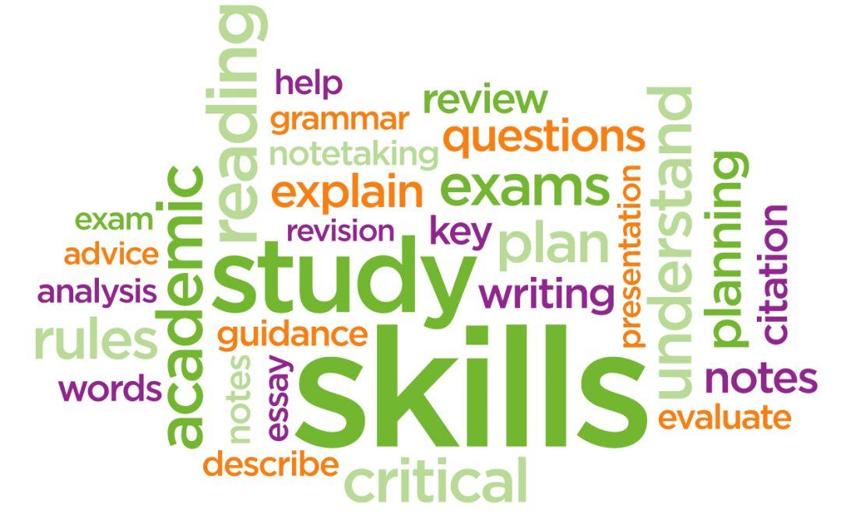

Preparing for Level 3 Vocational Qualifications at East Surrey College
Developing your Study Skills

Slide 2
Work Activity Brief

Slide 3
Submission
Once you have completed your project, please forward this to the following email address along with your full name: submissions@esc.ac.uk.
We’ll then forward this on to our curriculum teams who will be in touch shortly.

Slide 4

Your Transition to College
At East Surrey College we encourage our students to be independent learners. This means:
Being organised
Being self motivated
Being curious for learning
Being ready to contribute to learning

Slide 5
Developing your study skills
An effective learner gradually takes ownership of their own learning. However, this takes time and effort, requires support and guidance from your teachers here at ESC, and requires lots of study skills practice!
Why focus on study skills? Because reflecting on HOW we learn, is just as important as WHAT we learn. Click onto this link to discover more:
The importance of study skills

Slide 6

The 5 Step Challenge
OK, here's the challenge. You will be taken through 5 study skills Steps in the rest of this presentation linked to 5 related Tasks (A-E) .
Your aim is to work through the Steps and Tasks as effectively and efficiently as you can...
Target times to complete Tasks A-D:
90 mins: Gold Medal
120 mins: Silver Medal
150 mins: Bronze Medal
Good Luck!

Slide 7
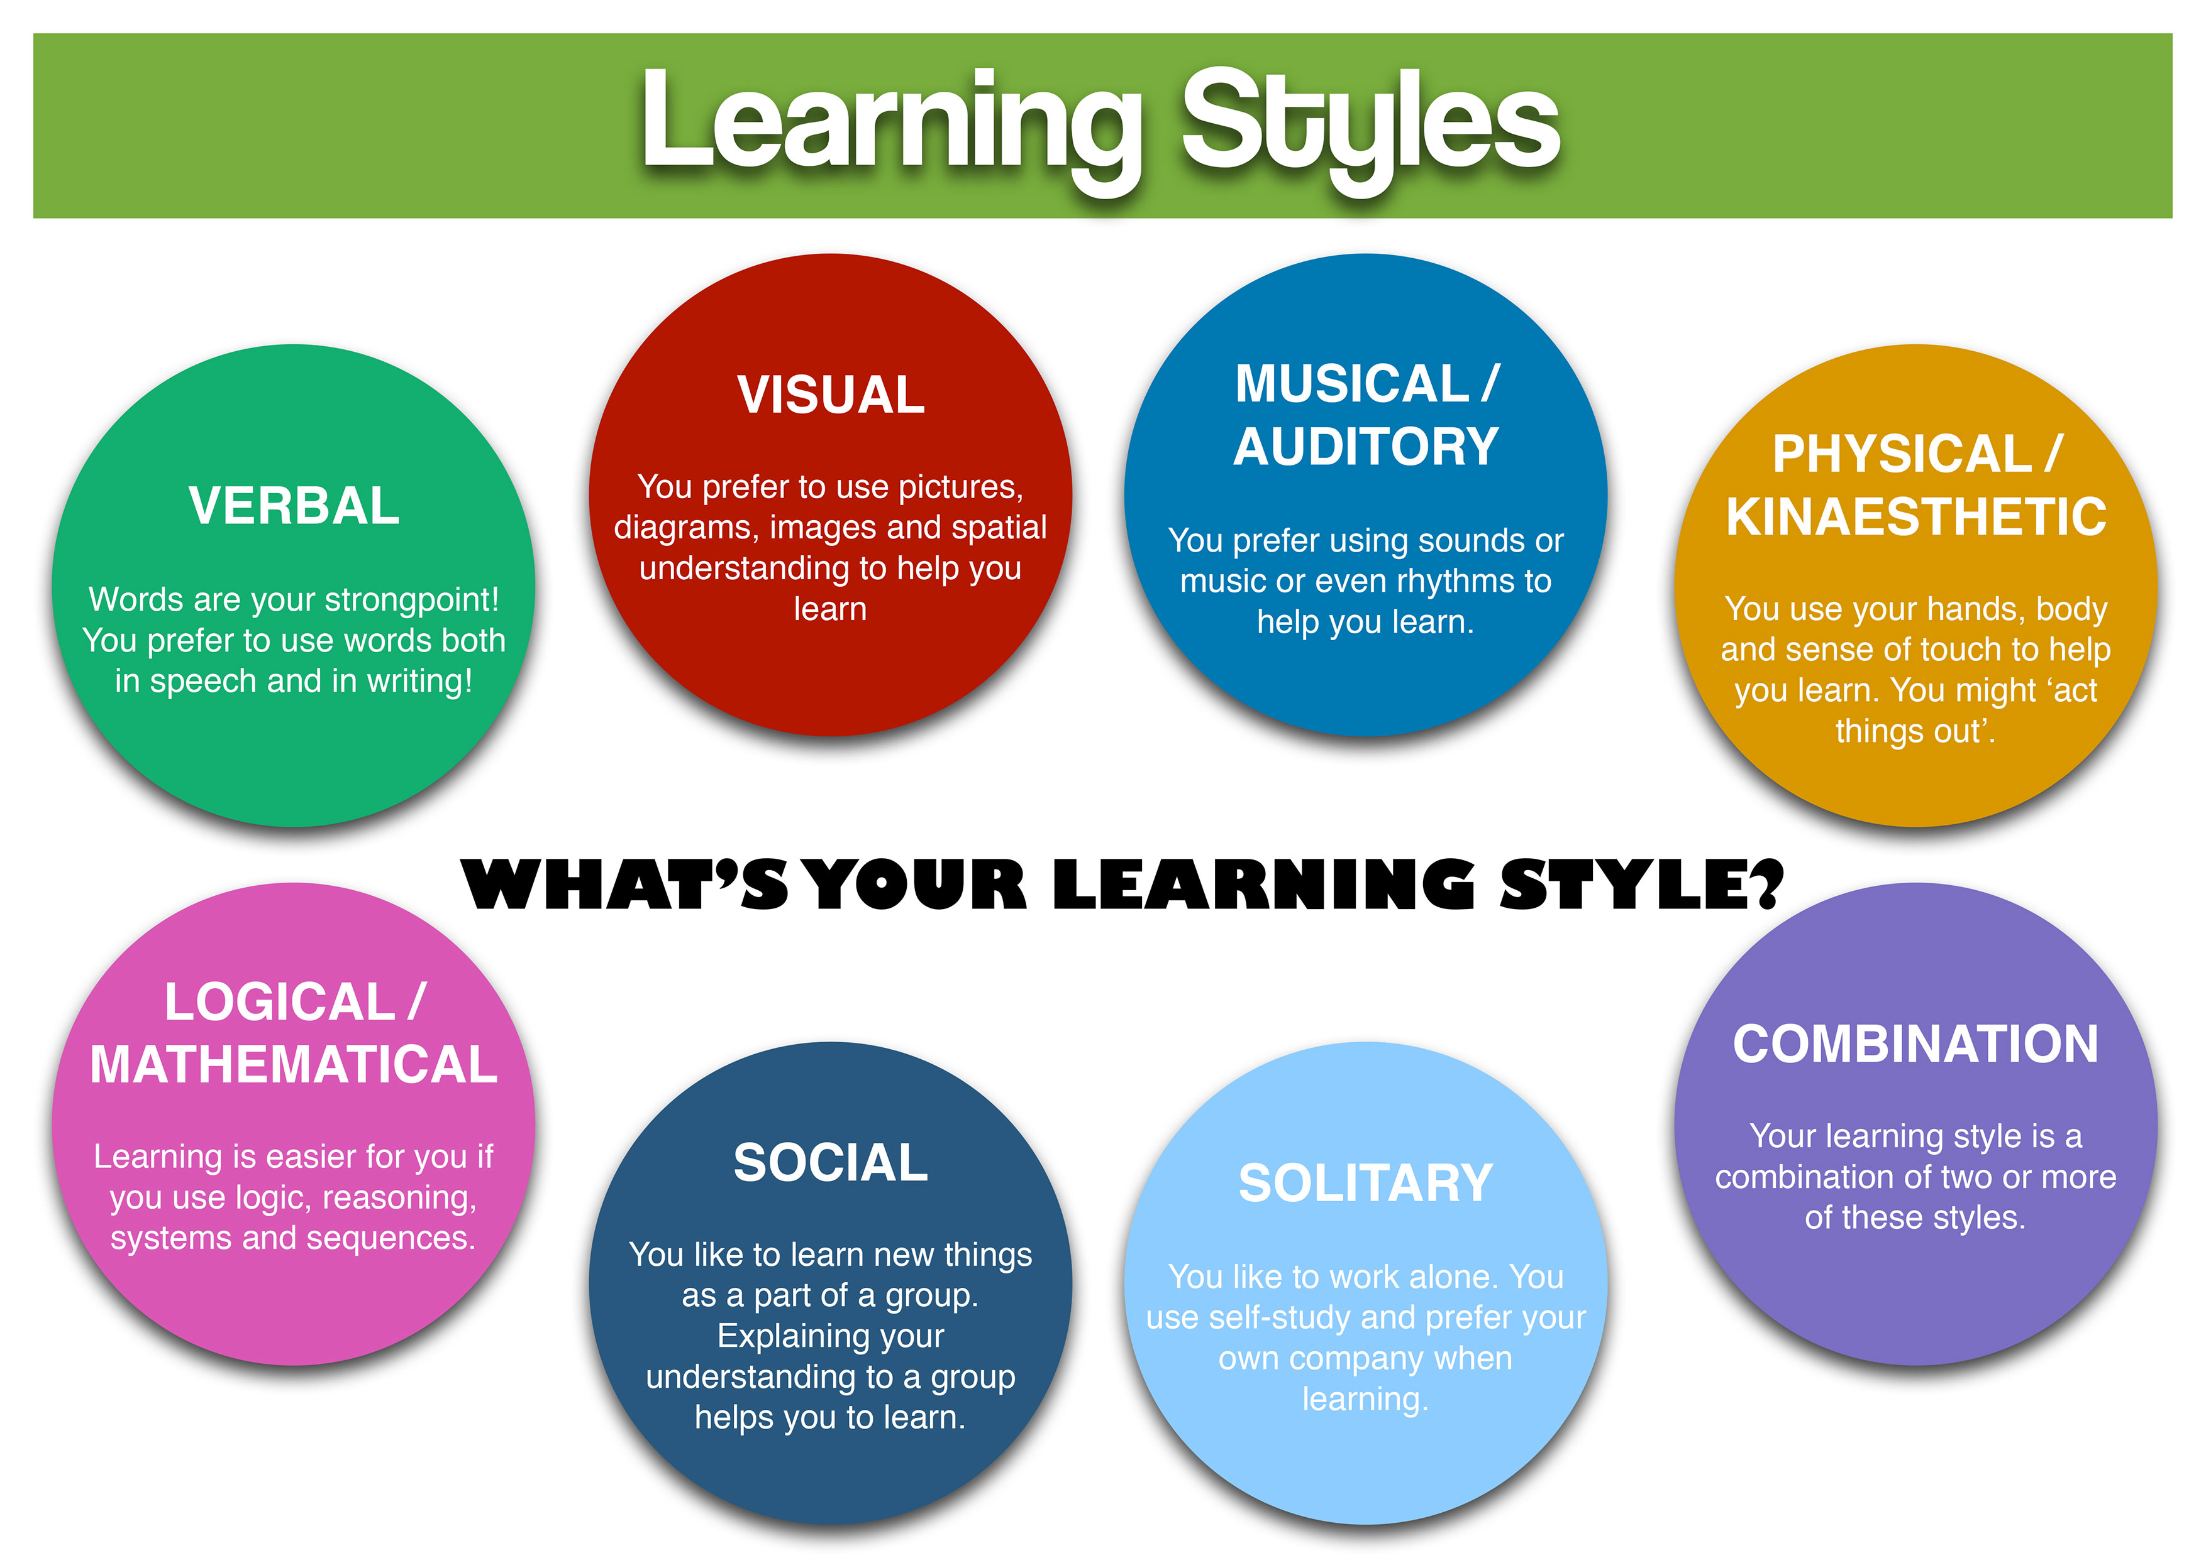
Study Skills Step 1: Reflection
So, the best place to start is reflecting on what type of learner you are. Here are 8 learning styles to choose from:

Slide 8
Study skills Task A
Give yourself a rating 1-10 for each learning style (excluding 'combination'). Then select the two highest scores – these reflect your study strengths! Then select the two lowest scores – these are the key study areas to work on.
My strongest study styles are: | My styles to work on are:

Slide 9
Study Skills Step 2: Research
Many of the learning activities and assessments at college will require you to carry out independent research. Most of this will be on-line, whether using course e-learning materials or using internet search engines.
How good are your search engine skills? Take a look at this video clip and then decide:
Improving your search engine skills

Slide 10
Study Skills Task B
Now let's test your search engine skills!
Choose a topic – it could relate to one of the Level 3 courses you will be studying next year. For example: photosynthesis (science), The National Crime Agency (public services), lymphatic drainage (beauty therapy)
Using your search engine skills, find 10 key facts about your topic, using at least three different sources of information
Record these key facts, citing your sources each time i.e. name of web-site, publication, author, date of publication etc.

Slide 11
Study Skills Step 3: Record
After you have written down your key facts, you need to add to these by finding and watching a short You Tube video clip (approx. 3 mins) on your chosen subject.
While watching the clip...take notes. Before you start, this You Tube clip will show you the best way to do this – a great method to improve your note-taking skills:
The Cornell Note-taking method

Slide 12
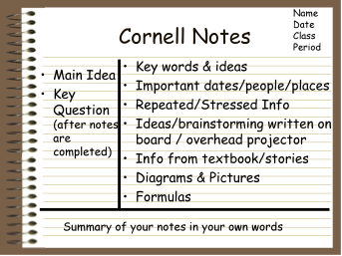
Study Skills Task C
Watch your own selected video clip and take notes using the Cornell method, finishing with a short topic summary at the bottom of the page.

Slide 13
Study Skills Step 4: Recreate
The next step is to recreate the information you have researched into a different format and using your own words.
The challenge is to develop your writing skills, so the content is not just based on the description of facts, but also provides explanation, analysis and evaluation.
Read through the research you have carried out and use highlighters to identify the main facts you want to describe; which of these points you wish to explain or analyse further; and which ideas you would like to evaluate upon.
If you are unclear about any of the words in bold, use your search engine skills to find clear definitions with examples.

Slide 14
Study Skills Task D
You have been asked to write a short review of your topic (100-150 words) for the college student newsletter.
It must include:
Description and explanation of selected key facts
Some analysis and evaluation (this could be your own opinion)
List of your referenced sources
A relevant picture/graphic

Slide 15
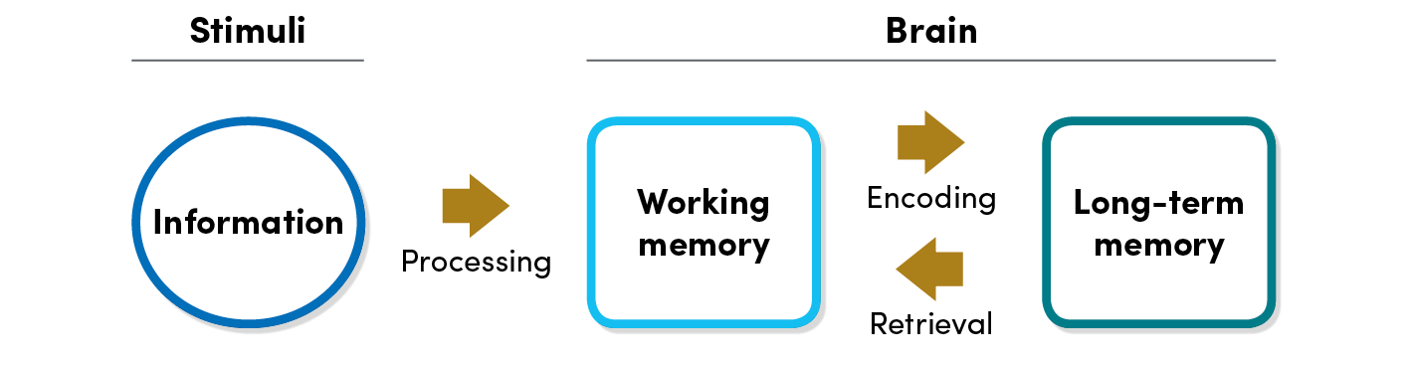
Study Skills Step 5: Retrieval
The key to learning success is to transfer information learnt from your short term or 'working memory' to your long-term memory. One of the most effective ways of doing this is through Practice Testing.
Actively testing your memory improves learning far more than passively reviewing or reading material over and over again.
Testing improves learning by exercising memory retrieval. When you answer a test question, you have to actively search your long-term memory. This makes the answer easier to find the next time around!

Slide 16
Study Skills Task E
So finally, you need to check your own knowledge and understanding of your chosen topic using practice testing.
From the content of your article, devise and write down 5 questions about your topic. Then put your notes and article away.
2 days later get a family member to ask you these 5 questions.
How did you do? If you got all 5 right, then give yourself a big pat on the back! If not, then reflect how you can do better next time.

Slide 17

Remember – practice your study skills and become an expert independent learner!

